Slide 1
مروری بر گایدلاین سپسیس

Slide 8
SEPSIS
Sepsis is life-threatening organ dysfunction caused by a dysregulated host response to infection
Early identifcation and appropriate management in the initial hours after the development of sepsis improve outcomes.
Observational studies suggest that mortality may increase after intervals exceeding 3–5 h from hospital arrival and/or sepsis recognition

Slide 9
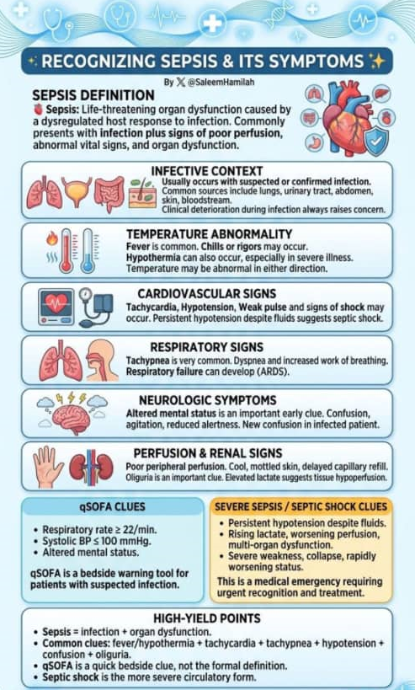
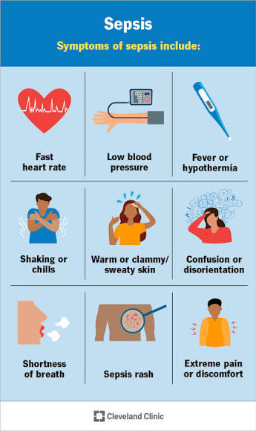

Slide 10
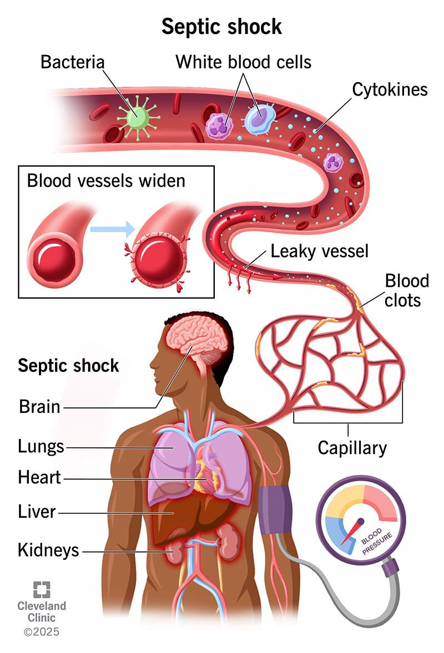

Slide 11
Key new recommendations of the Surviving Sepsis Campaign guidelines 2026

Slide 12
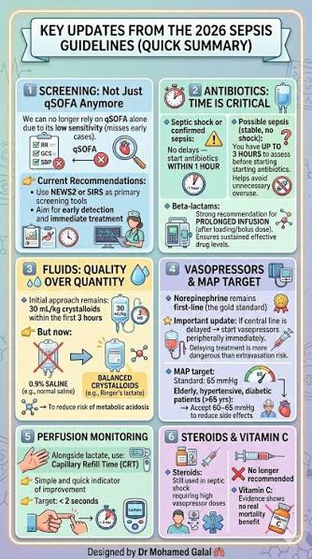

Slide 13
Screening and early management
Use a sepsis screening tool for critically ill adults en route to the hospital by ambulance or flight
Collect blood cultures as soon as possible, ideally before the administration of antimicrobial therapy
In sepsis-induced hypotension, use an initial intravenous crystalloid fluid bolus resuscitation followed by early vasopressor support if hypotension persists
In patients with septic shock aged 65 years or older, aim for an initial MAP range of 60 - 65mmHg

Slide 14
Infection
Hemodynamic management
Respiratory support

Slide 15
Additional and adjunctive therapies
In patients with sepsis and fever, do not use antipyretic therapy, either pharmacologic or surface cooling, for improving clinical outcomes
In sepsis, do not use probiotics
In septic shock after the acute resuscitation phase, use active fluid removal

Slide 16
Goals and transitions of care
Implement strategies to ensure that patients being discharged from the hospital after sepsis can execute advanced directives
In sepsis, perform comprehensive medication reconciliation using a drug-based approach at transitions in care
Implement strategies to support sepsis survivors and their families during the post-hospital recovery
In sepsis survivors, offer services that support mental health after hospital discharge

Slide 17
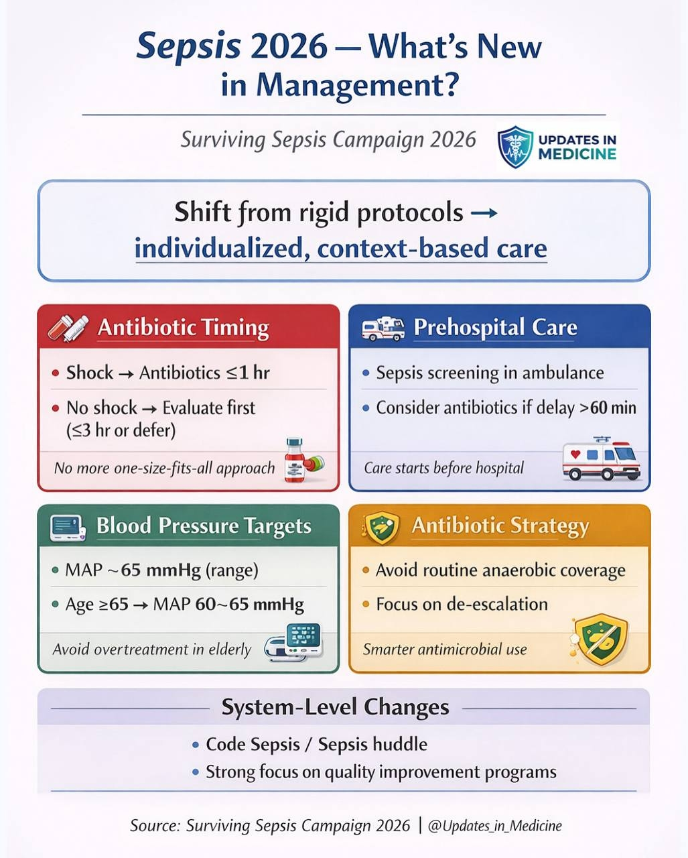

Slide 18
